Slide 2
Be Self Aware of our own Culture lens to Self-Evaluate our Tendencies, Attitudes and Stereotypes that Unconsciously Affect our Actions and Perceptions
Understand what it takes to be a Culturally Responsive Leader
Address the Biases that lead to the disproportionality that impact behavior and academic achievement

Slide 3
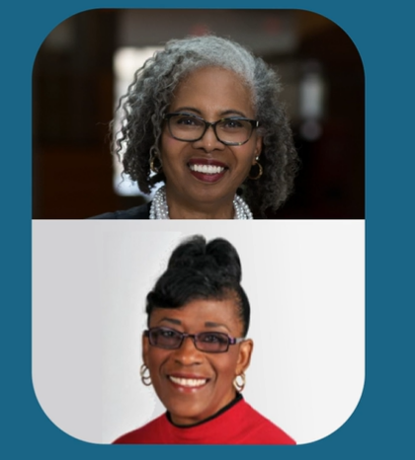
Introduced by Dr. Gloria Ladson-Billings and further developed by Geneva Gay
culturally responsive teaching is a strengths-based approach
Rather than focusing on real and perceived deficits, educators are challenged to identify and leverage students’ strengths, cultures, lived experiences, and current societal issues

Slide 4
Why it is important for leaders to focus on Cultural Responsiveness
Academic Achievement
Bias and systemic educational barriers
Students and staff who are impacted by biases

Slide 5
All schools benefit if we…..
Set high academic expectations, focusing on student assets and strengths.
Expand learning opportunities, incorporate performance styles
Address implicit bias and systemic barriers
Build cultural competence of students and staff
Empower students to engage in their education by increasing their sense of belonging and connectedness

Slide 6
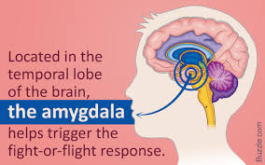
IMPLICIT BIAS DEFINED
Implicit bias refers to the attitudes and stereotypes that unconsciously affect people's perceptions, actions, and decisions (Kirwan Institute for Race and Ethnicity
Implicit biases often stand in opposition to a person's stated beliefs.

Slide 7
Thinking Job Question
As a leader of adults and students, am I aware of my own cultural Len and biases that leave others behind or create barriers to education and/or cause low moral with those I lead or work with?

Slide 8
What Do Great Leaders Do?

Slide 9
THE $100 RACE

Slide 10
What were your initial emotions and thoughts?
What did you learn about yourself?
What implications does this have in our relationships and school culture/environment?
CHAT

Slide 11
CULTURALLY RESPONSIVE LEADER
CHAT
Talk

Slide 12
CULTURALLY RESPONSIVE LEADER
Recognize one’s own cultural lens and biases
Ability and willingness to have a culturally responsive mindset
Committed to creating energy and high moral to accomplish shared goals and vision
Develop Effective Strategies that lead to High Expectations and Rigorous Instruction that challenges all students & actively involves them in their learning.
Dedicated to Building a Caring Community
Commitment to Building & Maintaining Healthy Relationships

Slide 13
HIDDEN BIASES
Ingrained habits of thought that lead to errors in how we perceive, remember, reason and make decisions.
Culture Developer - Creates a strong culture where learning thrives and habits for success are developed.

Slide 14
Ant
Spider
Feelers
Web
Fly
Poison
Slimy
Crawl
Bee
Wing
Bug
Small
Bite
Fright
Wasp
Creepy

Slide 15
25 Types of Mindbugs
False Memory

Slide 16
False Memory Test
Copy all of the words from list below that you recall seeing on the previous list and leave out any word(s) that by your recollection, that did not appear before:
Maple Ant Poison Fly Stem Berry Feelers Slimy Birch Wing Leaves Tree Roots Bite Web Bug Small Oak Crawl Acorn Wasp Branch Insect Bee Willow Fright Spider Pine Creepy

Slide 17
Words that should have been copied in blue:
Maple Ant Poison Fly Stem Berry Feelers Slimy Birch Wing Leaves Tree Roots Bite Web Bug Small Oak Crawl Acorn Wasp Branch Insect Bee Willow Fright Spider Pine Creepy
Do you have False Memory Mindbug ?

Slide 18
Measuring Your Biases
An effective way to begin the process of engaging with implicit biases on a conscious level is to identify those biases. The Implicit Association Test (IAT) can be a helpful way to start the process. Select an Implicit Association Test based on an area you are interested in exploring.
*Link will be listed in chat at the end of webinar to explore later.

Slide 19
Overcoming
Introspection: Set aside time to understand your biases
Mindfulness: Once you understand the biases you hold, be mindful that you’re more likely to give in to them when you’re under pressure or need to make quick decisions.
Perspective-Taking: If you think you may be stereotyping people or groups, imagine what it would feel like for others to stereotype you.
Learn to Slow Down: Before jumping to conclusions about others, remind yourself of positive examples of people
Individualization: Remind yourself that all people have individual characteristics that are separate from others within their group
Check Your Messaging: Instead of telling yourself that you don’t see people based on their color, class, or sexual orientation, learn to use statements that embrace inclusivity.
Institutionalize Fairness: Learn to embrace and support diversity.
Take Two: Overcoming biases takes time.

Slide 20
IDENTITY DIMENSIONS ACTIVITY
Name
Gender
Hobbies
Race
Age
Favorite Food
Identity Dimensions
Gender
Race and Ethnicity
Languages spoken
Interest & Hobbies
Religion/Spiritual Beliefs
Family
Preferred Types of Music
Identity Dimensions
Age
Sexual Orientation
Physical Characteristics
Economic Class
Favorite Foods
Preferred Sports; participant of viewing
Use the identity Dimension to Complete
Think about….
Things that are most important to my personal identity.
Things that are less important to my personal identity.
Which of these characteristics are visible, and which are invisible?

Slide 21
Create a culturally responsive climate
FOSTER RELATIONSHIPS - between district leadership and staff
BUILD TRUST FIRST -Build trust and establish relationships prior to providing professional
development.
BE TRANSPARENT- about the reasons for professional development and create a thriving,
culturally responsive professional learning community.
KNOW YOUR DISTRICT AND YOUR BUILDING - whether using an external consultant or a
qualified district staff member, devote sufficient time to learn about your district
characteristics, needs, and interests.
ENGAGE STAKEHOLDERS– develop partnerships with students, families, and community members to provide opportunities for voices to be heard
USE DATA TO PROMOTE EQUITY IN SCHOOL DISPLINE - leaders can review their own discipline data, disaggregated by racial/ethnic groups, to understand opportunities and challenges related to equity in discipline within their own schools.

Slide 22
Conclusion
Culturally responsive leadership improves learning outcomes and student discipline. The work of educational leaders is to ensure that teachers have the knowledge and skills necessary to ensure that every student receives the highest quality instruction every day. When educational leaders lack cultural understanding, they may react defensively in the face of diversity to maintain the status quo.

Slide 23
EXIT Ticket
Think about opportunities to engage in at least 1 activity on your campus that creates an atmosphere of safety that encourages the social, emotional and physical well-being of staff and students.

Slide 24
Q&A
What qualities do culturally responsive schools, classrooms, and teachers have?
What immediate, short-term, and long-term goals for culturally responsive can be set at the school, classroom, and teacher levels?
How does implicit bias manifest itself in schools? How do school leaders raise awareness of implicit bias among staff members to reduce unwanted disparities?

