Slide 1
Cracks in the Plate: Fostering Student Wellbeing for Safety & Success

Slide 3
Learning Objectives
Learn the link between mental wellbeing and school safety based on the most recent research.
Recognize signs and symptoms of mental health challenges.
Discover ways to make every student feel heard, understood, and important.

Slide 5
Talking about Mental Wellness

Slide 7
Adverse Childhood Experiences (ACEs)

Slide 8
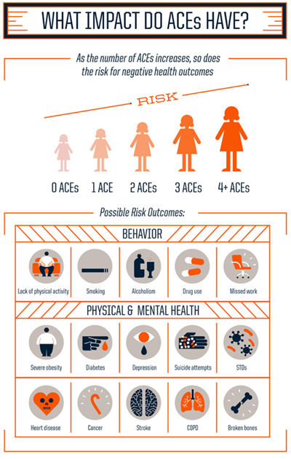

Slide 9
Risk and Protective Factors
emotionallysafeschools.

Slide 10
What if…….
It only takes one caring adult to help a young person build resilience.
Psychology Today, March 2023

Slide 11
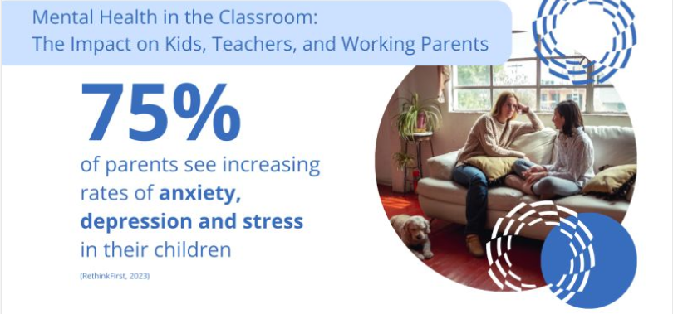

Slide 12
Signs and Symptoms
Changes in Behavior
Aggressive
Disrespectful
Hyperactive
Withdrawn
Changes in Friends
Extreme Mood Changes
Change in Eating Habits
Not eating
Overeating
Sleepy
Feelings of hopelessness
Thoughts of self-harm
Sad
Angry
Excessive worry
Nightmares

Slide 13
I’m not the counselor….
Acknowledge something may be wrong
Are you ok?
Listen.
Reassure.
Give self-help strategies.
Refer to the school counselor if needed.
Watch for changes.

Slide 14
Teaching Students To Manage Emotions
Deep Breathing
Exercise
Healthy Eating
Journaling
Lean into creativity- art, music, and drama
Join a club- become a part of an organization

Slide 15
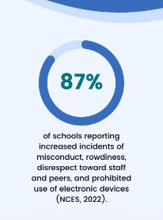
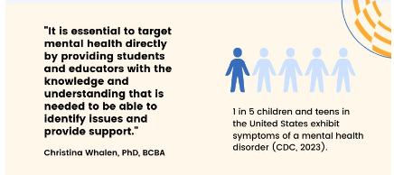
RethinkEd_-_White_Paper_-_Preparing_Educators_to_Address_the_Rising_Problem_of_Behavior_Problems_v30.pdf (brandfolder.io)

Slide 16
Bullying
Based on research, building empathy can reduce bullying incidents in schools.

Slide 17
4 Things School Shooters Have In Common
Early Childhood Trauma
Anger over a recent event
Inspired by other school shooters
Have the means

Slide 18
4 Things School Shooters Have In Common
Early Childhood Trauma
Train all staff to recognize the signs of a mental health crisis
Provide school-based mental health services
Create a framework to include:
Academic Support
Positive Behavior Support
Mental Wellness
Social and Emotional Wellbeing

Slide 19
4 Things School Shooters Have In Common
Anger over a recent event
Anger Management Skills
Social Skills
Empathy

Slide 21
Vape, Suspend, Repeat

Slide 24
Resources
Kids_Mental_Health_and_Stress_in_2023.pdf (brandfolder.io)
Youth Mental Health First Aid
Strong for Life
ACEs Study-CDC
Preventing School Violence: Building a Safer Future
Vape Free Schools

Slide 25
Amie Cumming
Director of Account Management
amie.cumming@rethinked.com

