Slide 1




SPED Skills Suite
2022 Overview

Slide 2



Special Education
The Many Faces of Special Education
Notes:
The face of education in 2023 is one of diversity and inclusion. In a world where there is no such thing as a typical classroom - our approach to students with diverse learning needs must evolve.

Slide 3


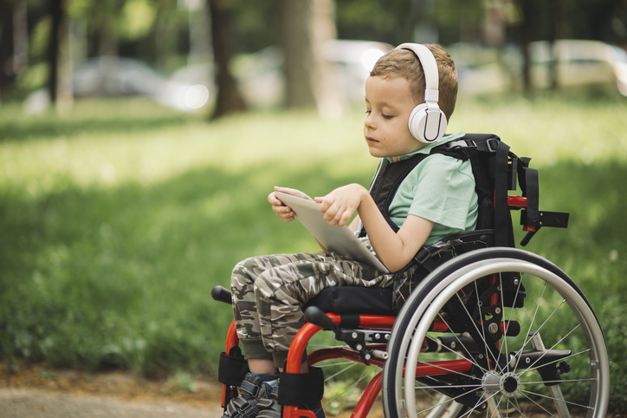



Individuals & IEP Focused
Notes:
As we look at our students with special education needs, we ALWAYS want to focus on the individual. It is the starting point, the vision, the I-in IEP.
Present Levels of Academic and Functional Performance
Measurable and meaningful goals and objectives
Accommodations and modifications
Fostering independence
Least Restrictive Environment

Slide 4

We Support the Entire IEP Team
Student
Parents/Caregivers
Advocates
Educators
Special Educators
Service Providers
Administrators
Notes:
As we develop Individualized Education Plans, the team is critical. That team includes the student, parents, educators, special educators, related service providers, and administrators to assess, design, and create a plan for student success.

Slide 5




Problems in Special Education
All students deserve access to curriculum
Educators are challenged to find differentiated resources
Administrators need to show compliance
Notes:
Curriculum that is rigorous and meets their individualized learning needs.
Differentiated resources to meet IEP goals and objectives.
Compliance for IEP & state mandated requirements.
Current products on the market are not flexible and cannot be customized
Content alternatives are not engaging and hard to find
Many products only address low incidence (1-2% population).
Up to 20% of the student population is on an IEP and require legally mandated accommodations

Slide 6
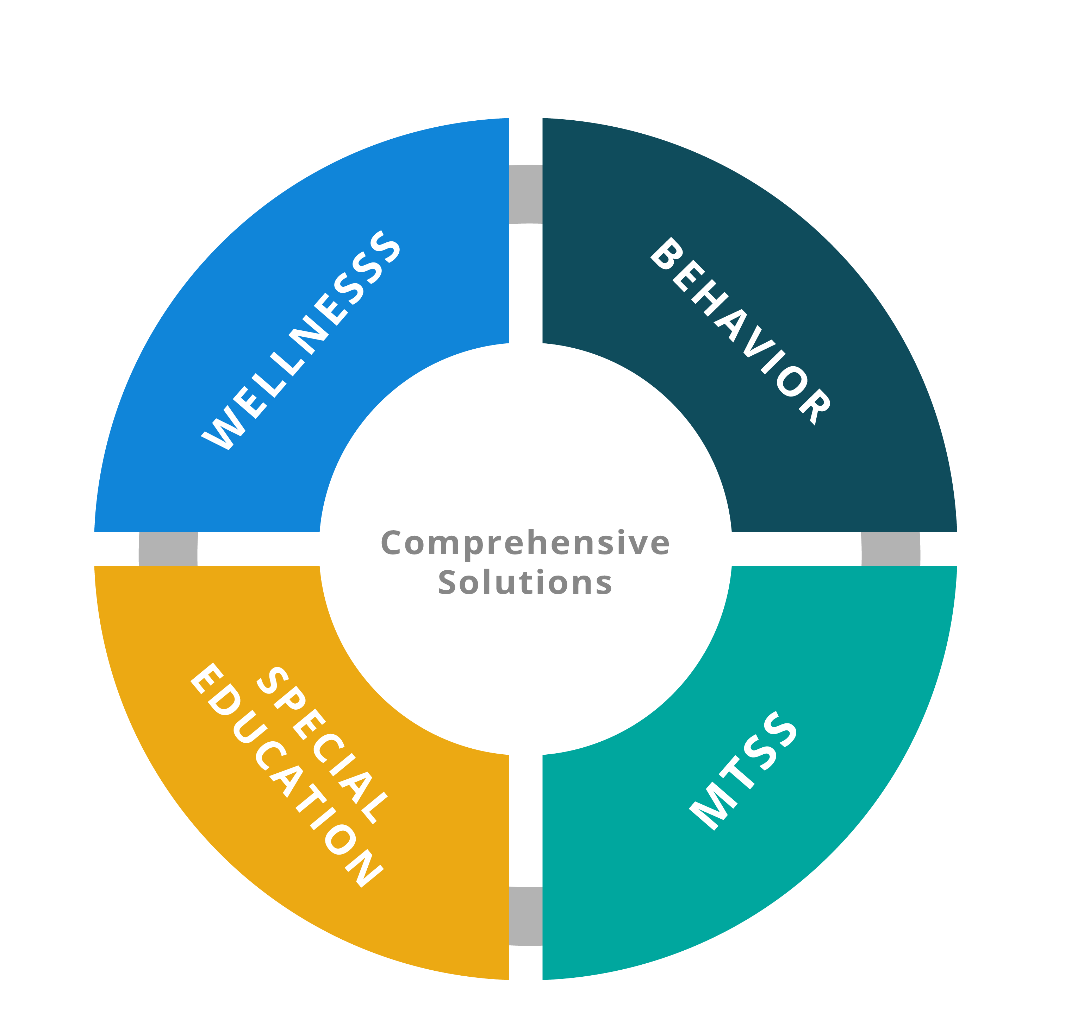
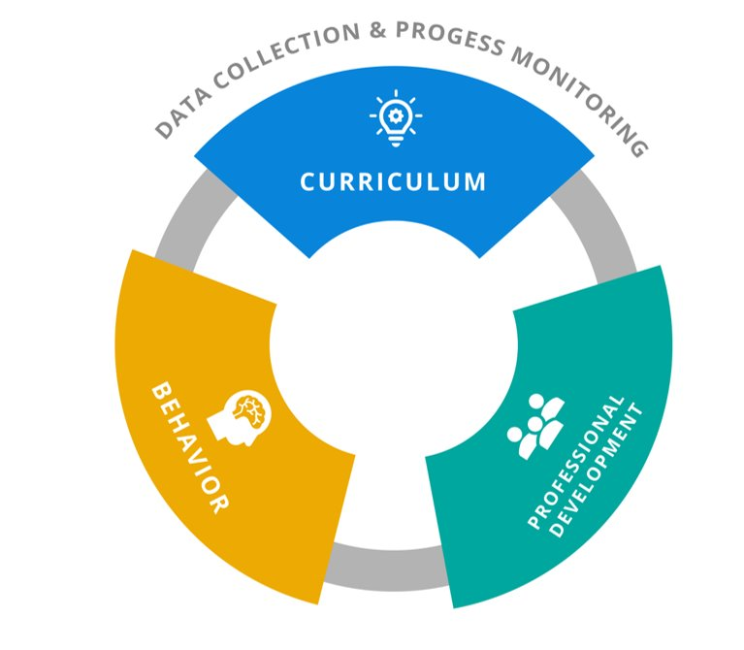
Our Special Education Solutions
Notes:
Background information on Vizzle and Rethink Autism
Vizzle’s K-12 Curriculum with its roots in research by the Monarch Center for Autism and Universal Design for Learning, continues to evolve supporting students with diverse instructional needs. Bridge the learning gap with rigorous, standards-based, academic curriculum for intervention and a new SPED Skills Suite coming out in the Fall of 2023
RethinkEd’s Autism & Related Disabilities Solution supports teachers by providing guidance on the best practices of SPED instruction and creating and implementing effective behavior plans.

Slide 7
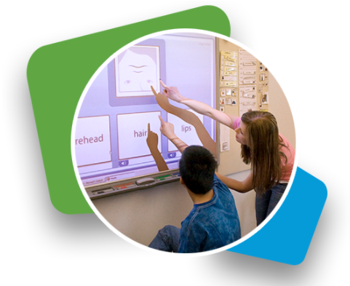
Why Vizzle?
Multi-tiered supports
Interactive, online activities
Accessibility options
Progress monitoring and reporting
Easily support IEP goals through ESY and Summer extension activities
Notes:
Easy to use
Lesson library with 40,000+ activities and growing; broad target audience… not just low incidence like competition
Units organized by topics that are aligned to specific state standards and many extended state standards
Unit guides and lesson plans to assist teachers
Activities can be personalized to meet students where they are at
Teachers can set up IEP goals and objectives in Vizzle and automatic data tracking; email notifications when mastery
Easy setup for ESY and summer extension

Slide 8


Who Vizzle Serves
Tier 3
Supports for students with the most intensive needs (1% - 5%)
Tier 2
5%-15%: Targeted Support for students on IEPs
Tier 1
80%: Universal support and screening for all students
Notes:
Vizzle is designed to support students with a variety of intervention needs.

Slide 9
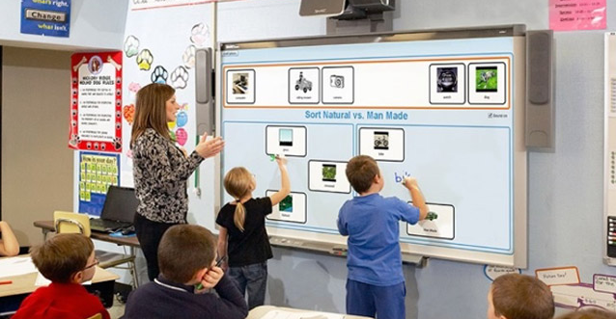
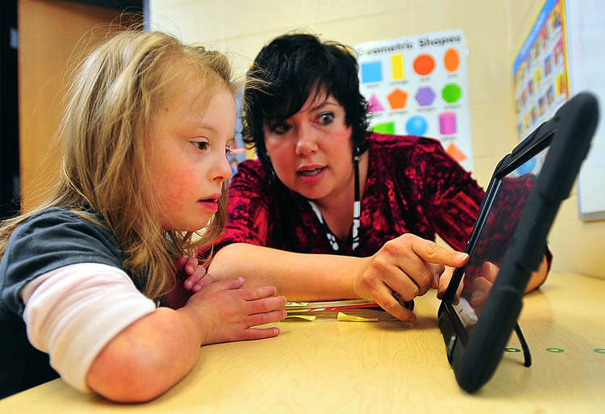
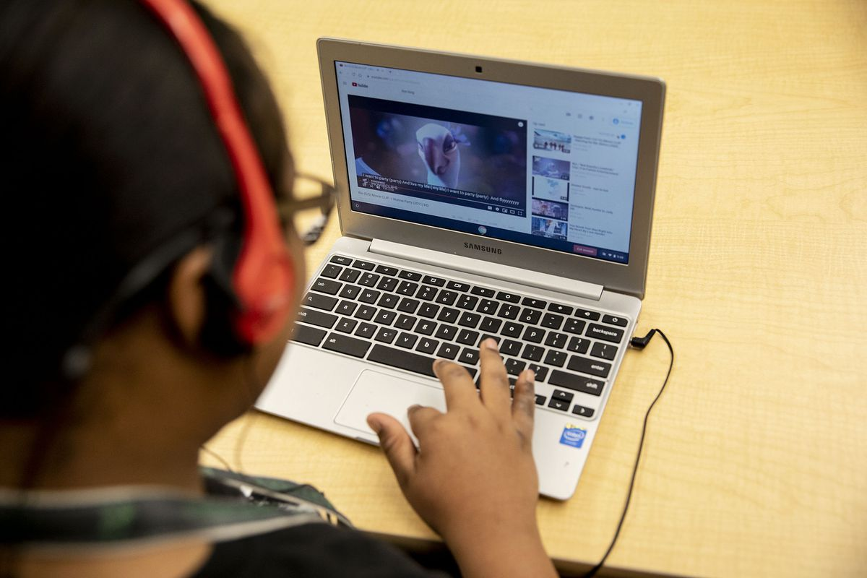
Instructional Settings
Whole Class Instruction
Small Group Work
1 on 1 Teaching
Independent Work/Homework
Assessment
Notes:
Use in diverse instructional settings to support students in a variety of ways!

Slide 10

Types of Content in Vizzle
Academic Curriculum
Special Education Skills Suite
Notes:
Academic Curriculum
Structured K-12 courses that provide tiered academic instruction aligned to standards. Organized by learning strands and standards to easily provide intervention and enrichment for diverse student instruction.
Special Education Skills Suite
Comprehensive suite dedicated to teaching & generalizing skills needed for functional daily living from kindergarten through transition.
(Fall 2023)

Slide 11
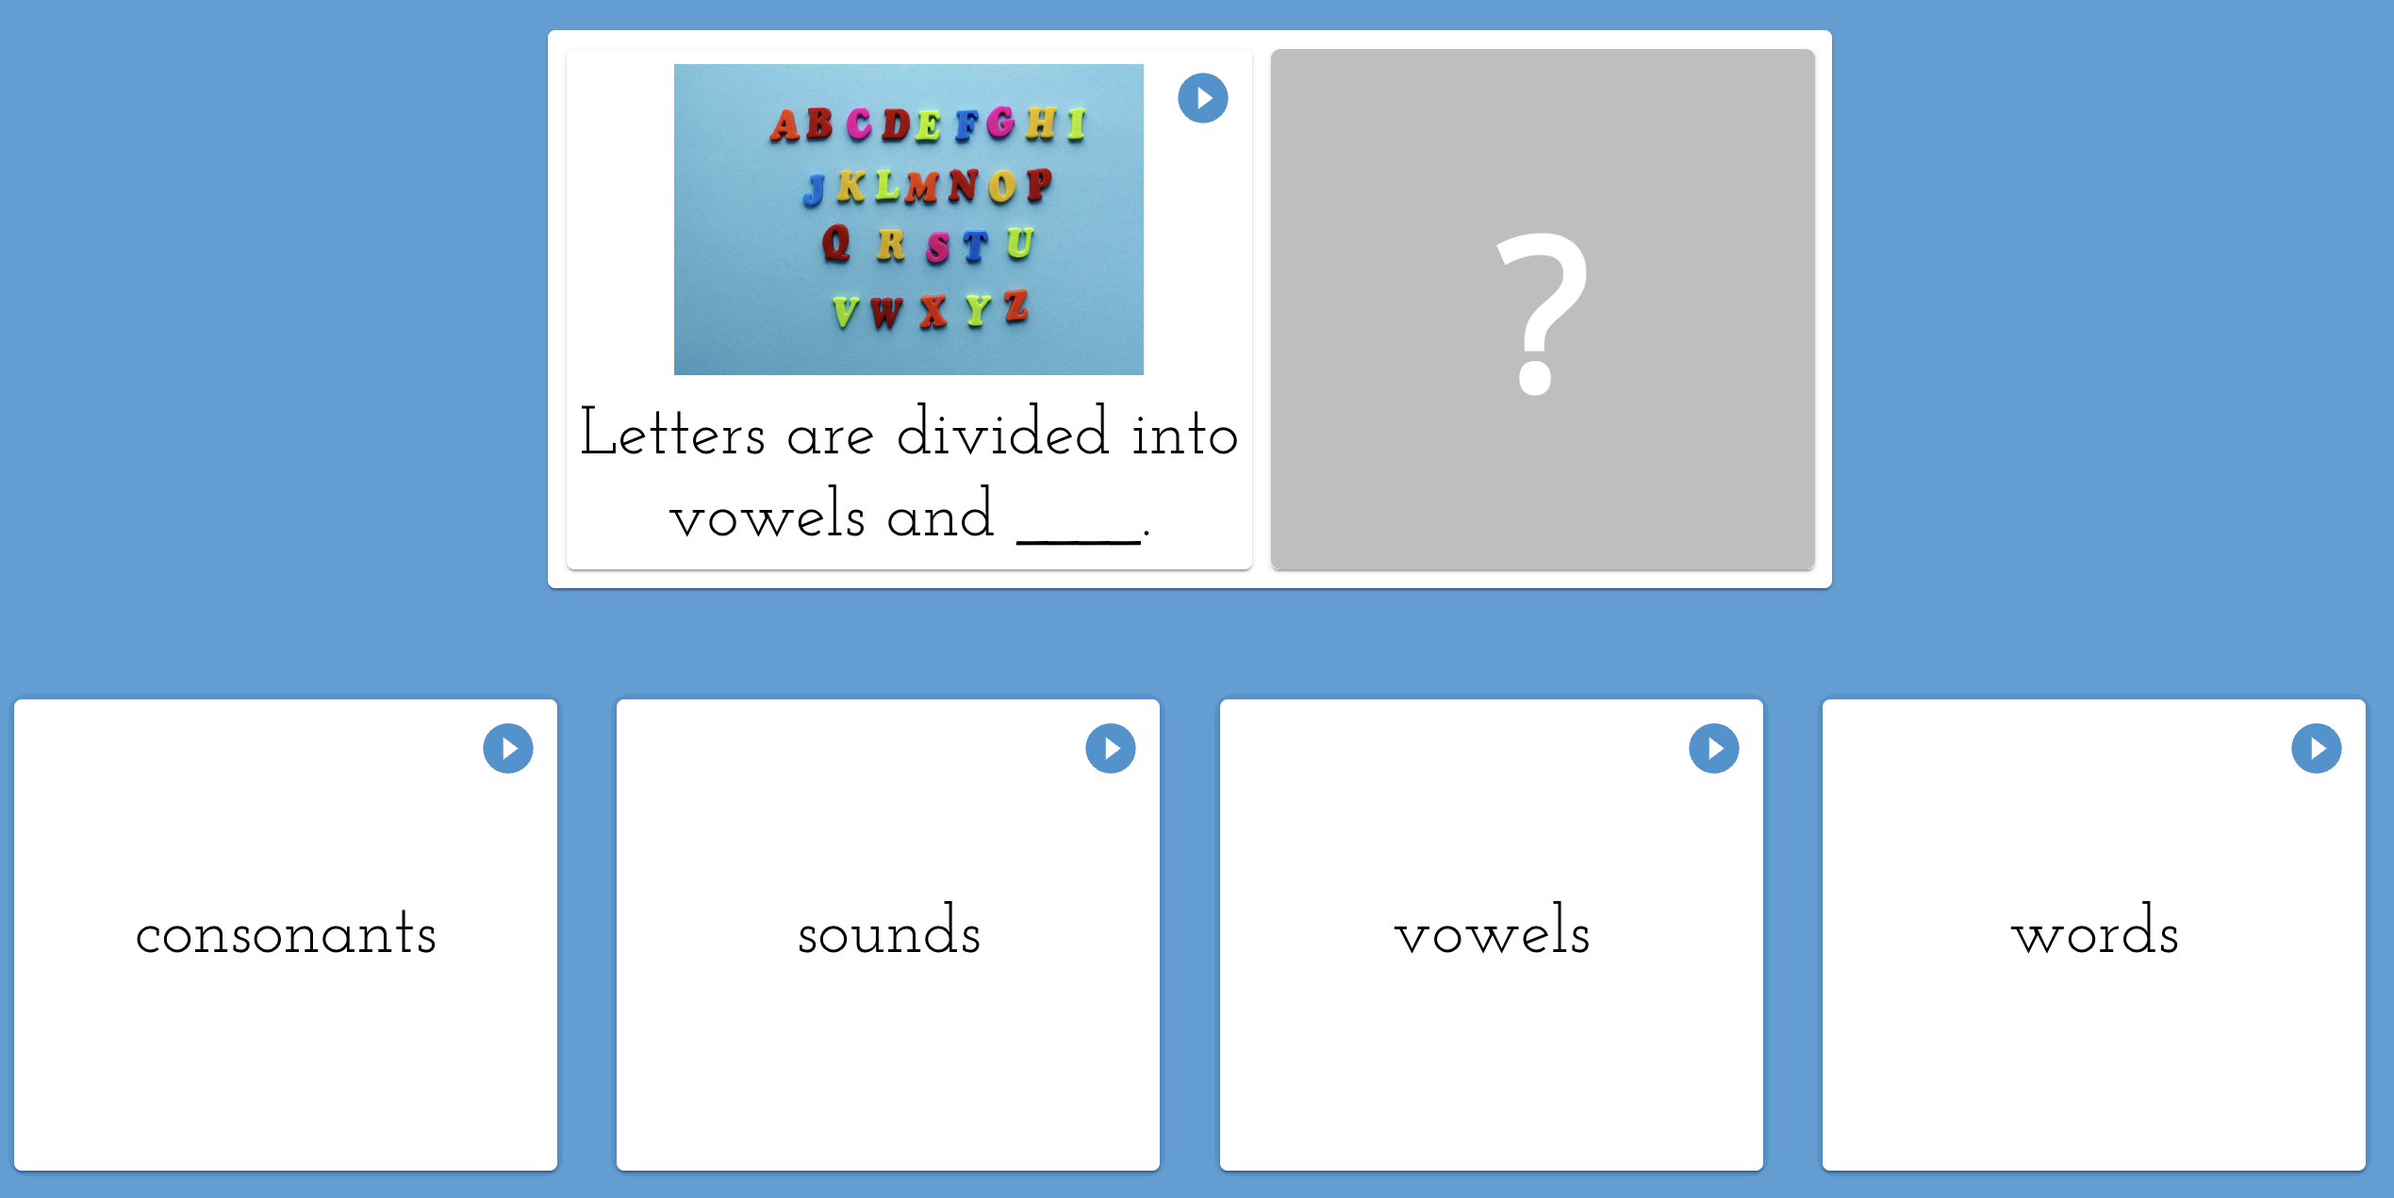
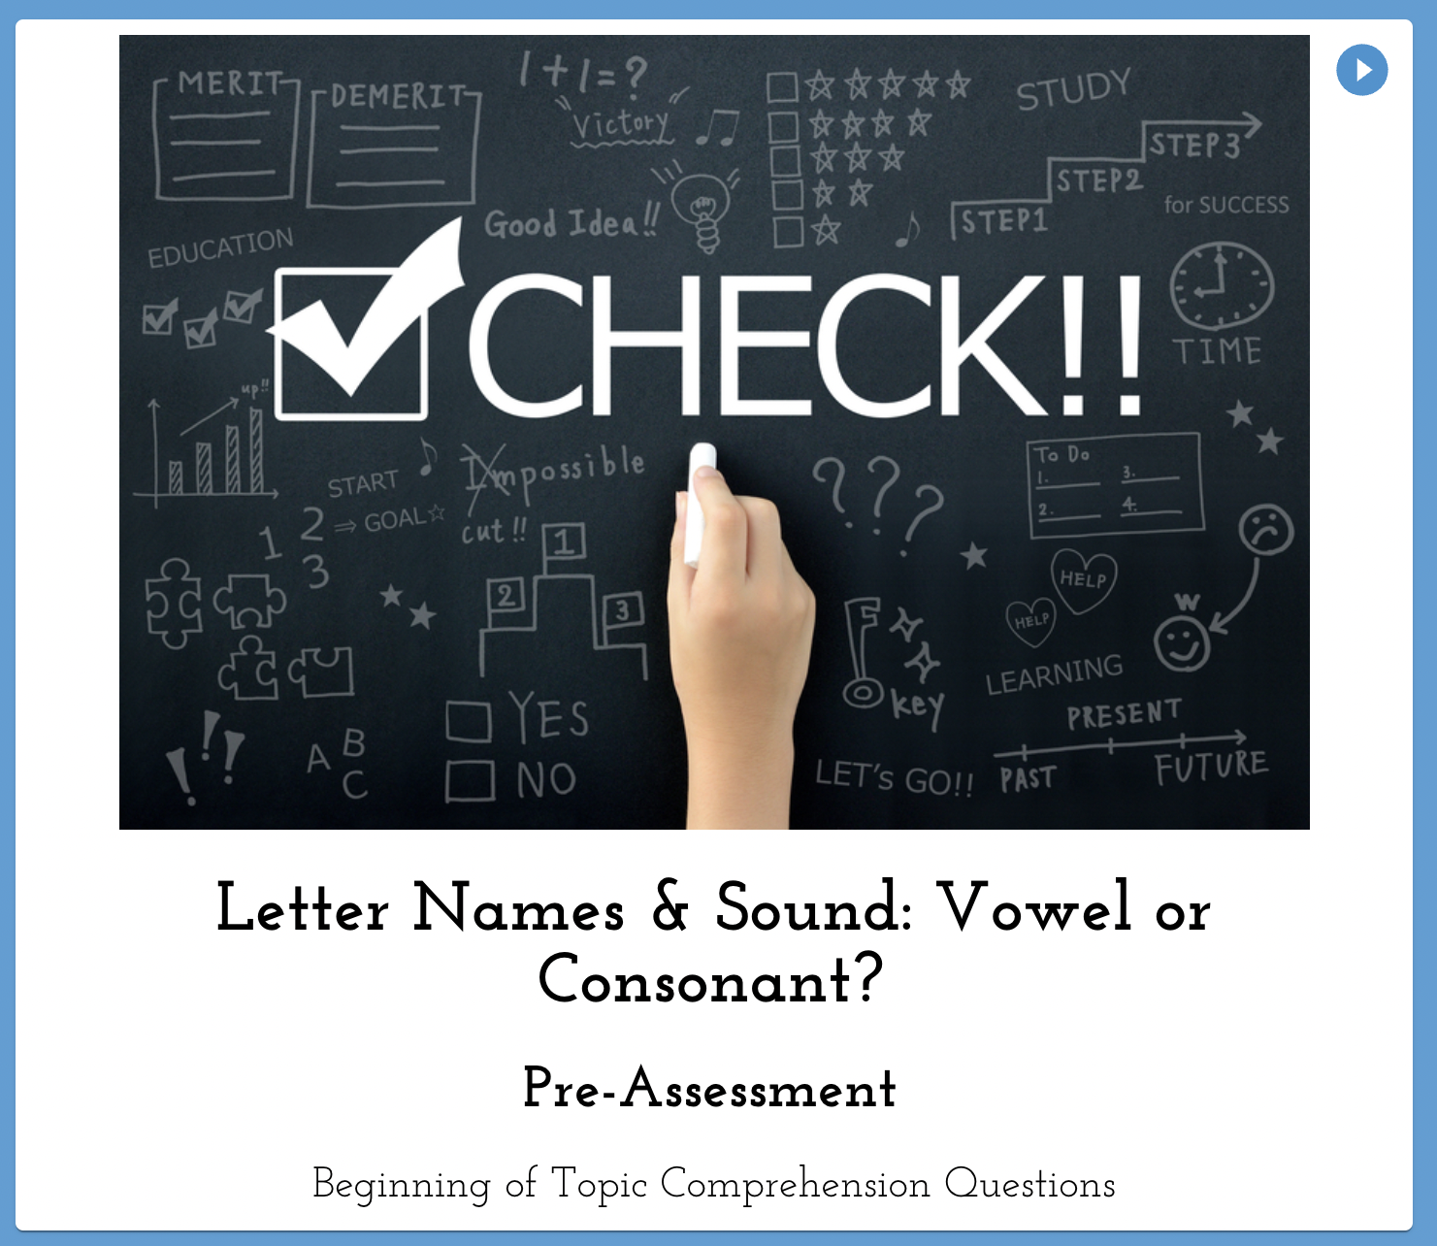
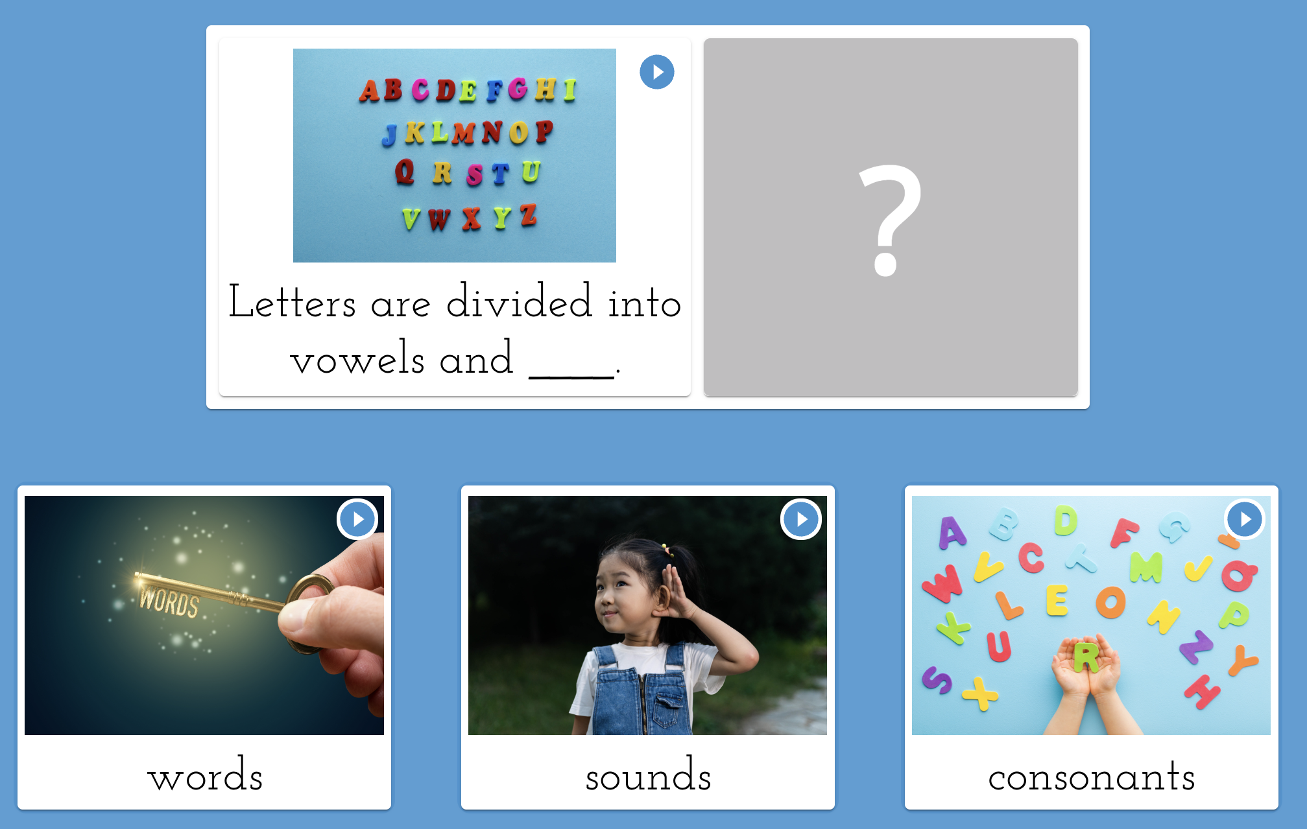
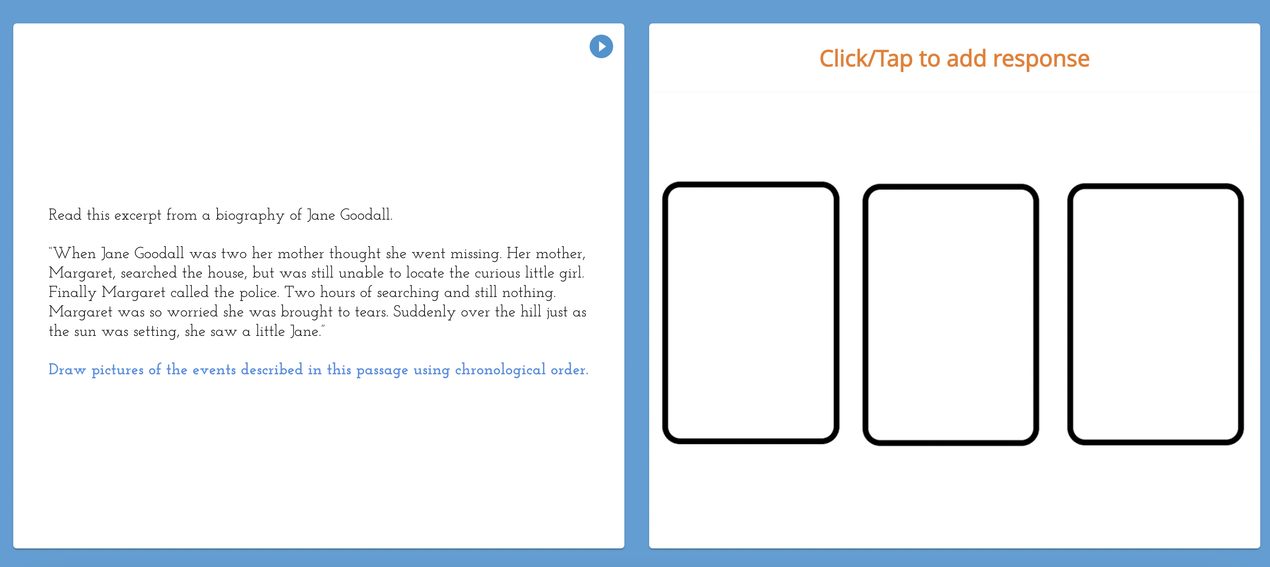
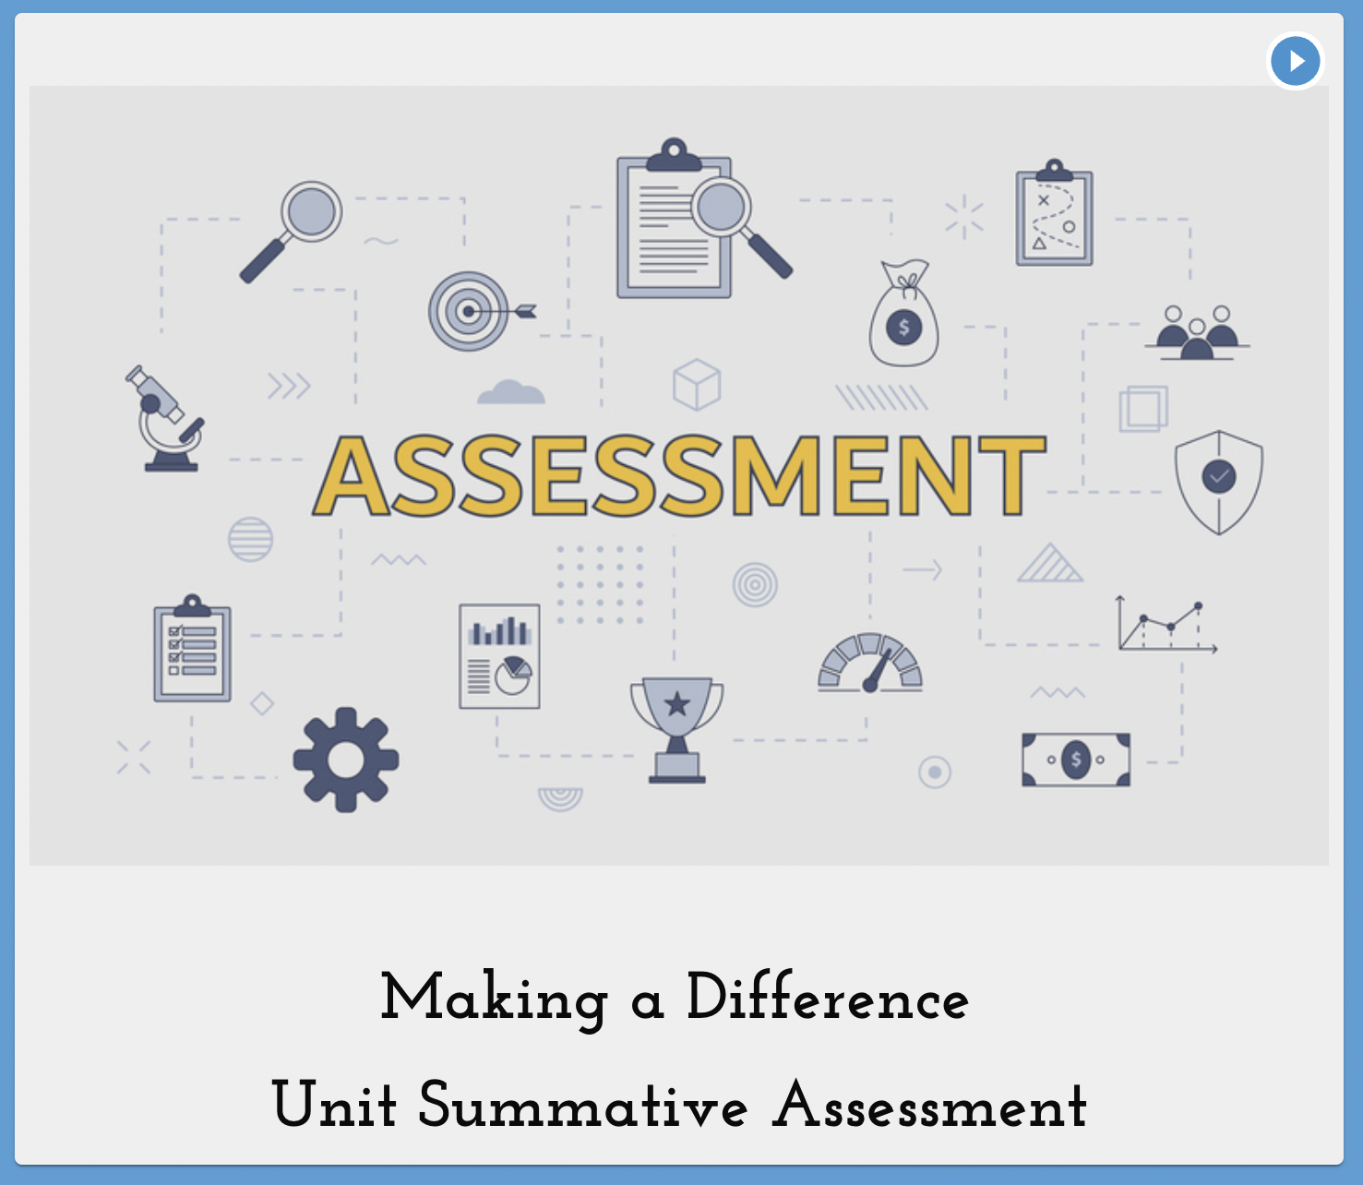
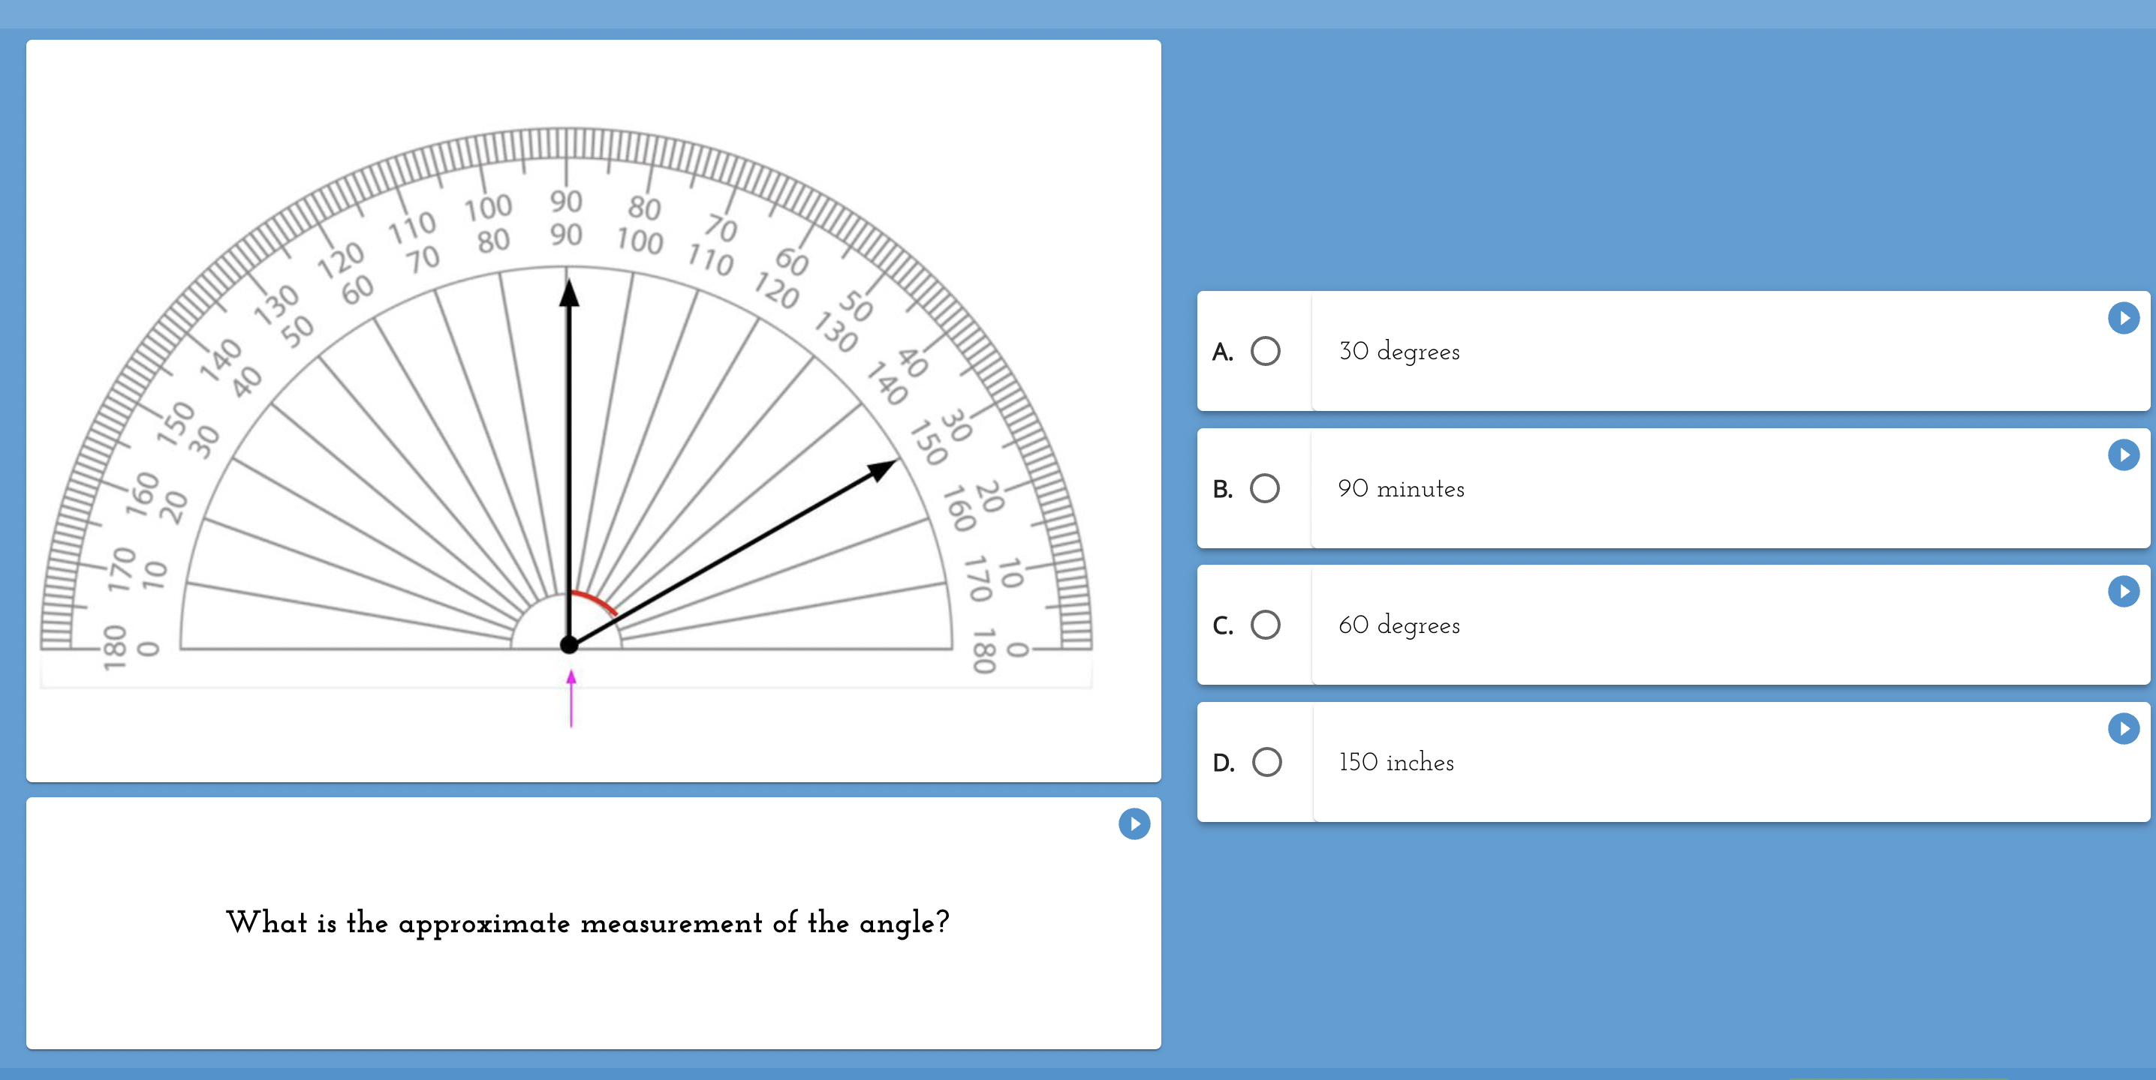
Assessments
Pre & Post Topic Assessments
Unit Summative Assessments
Notes:
Pre & Post Topic Assessments let teachers check for prior knowledge and skill mastery. (simple 10 question assessments to baseline and show progress)
Unit summative assessments check skill generalization with different depths of knowledge. (more summative at the end of multiple topics)
All lessons track formative data.

Slide 12
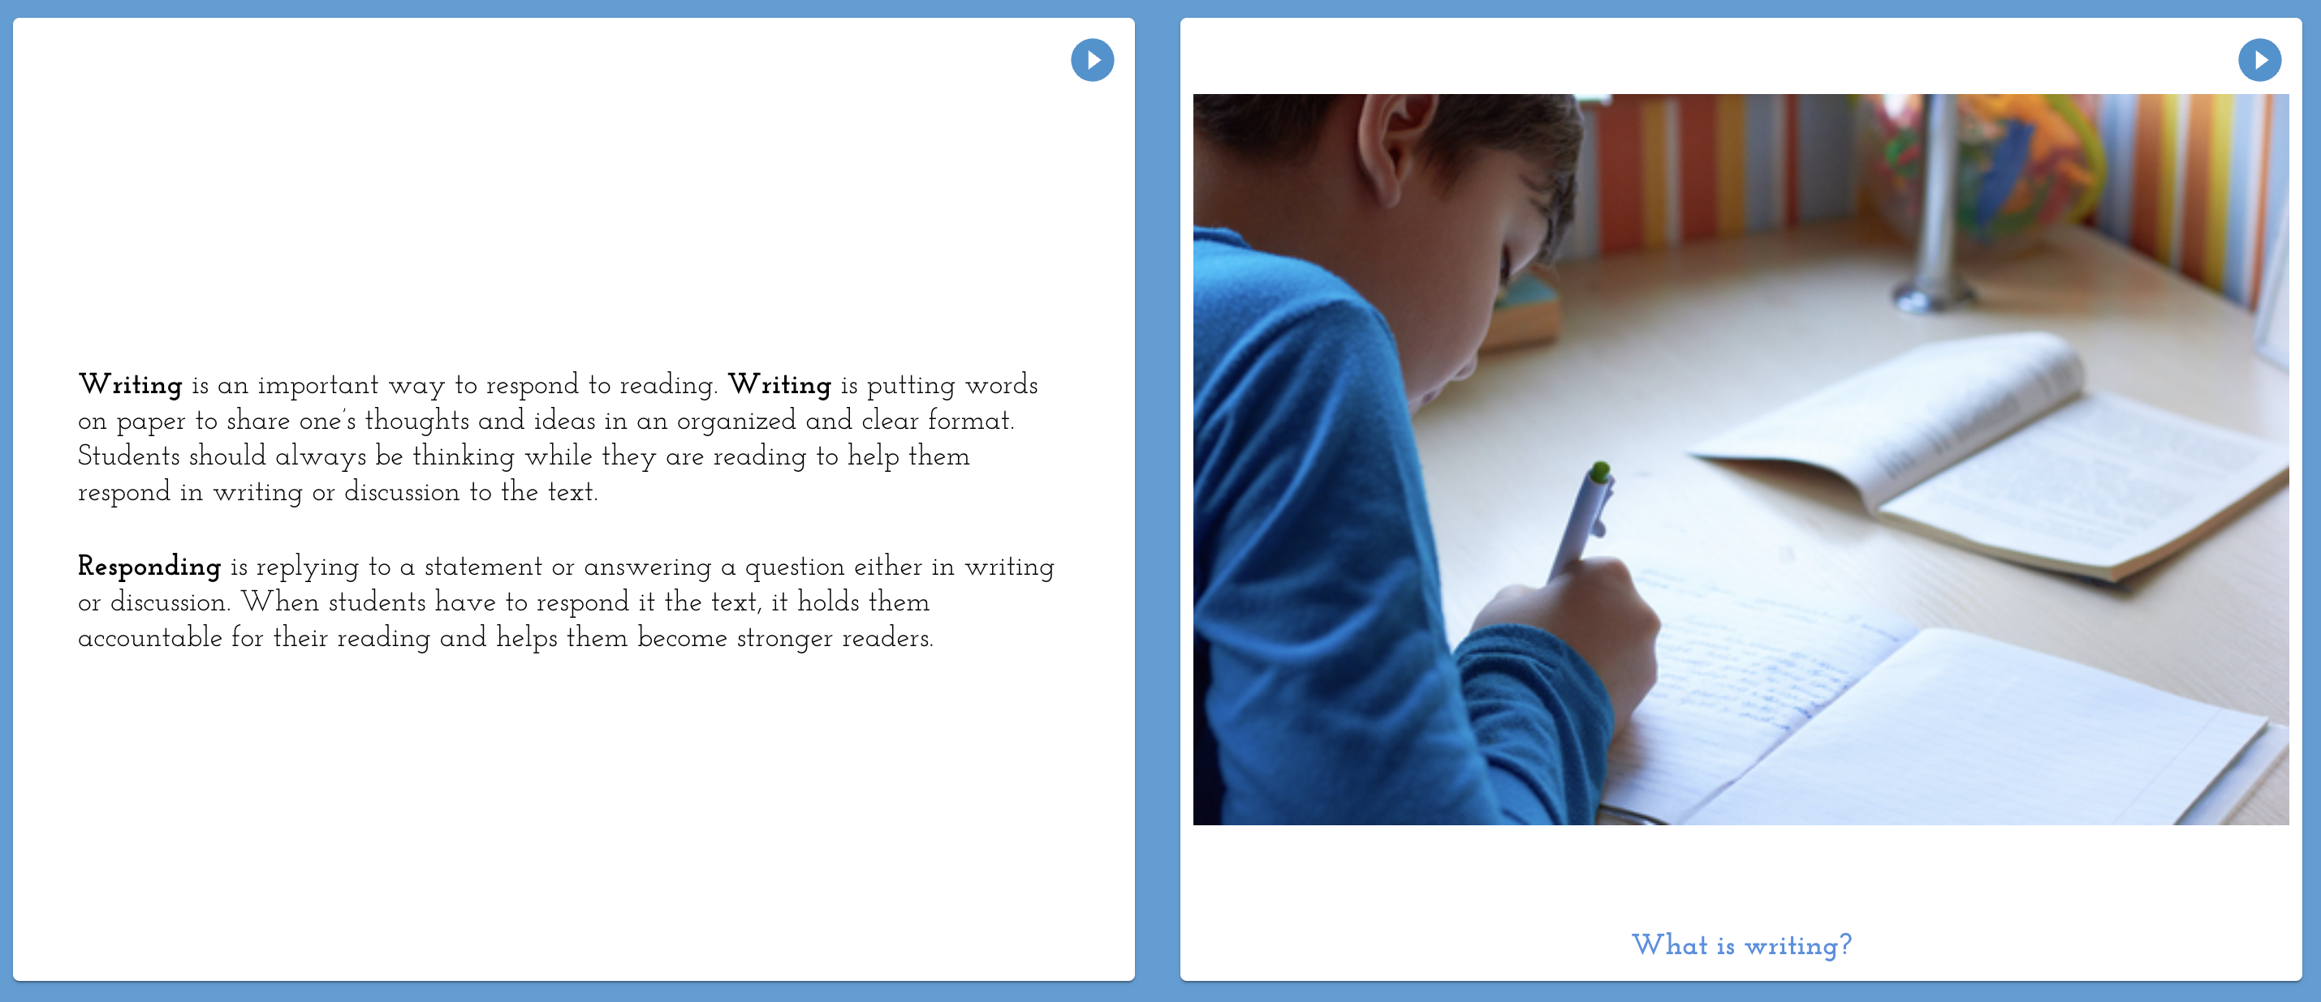
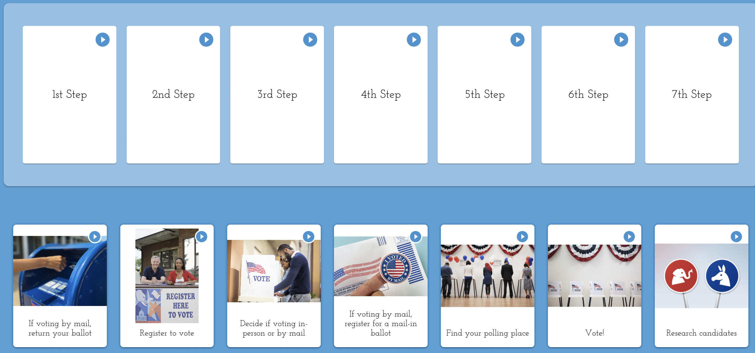
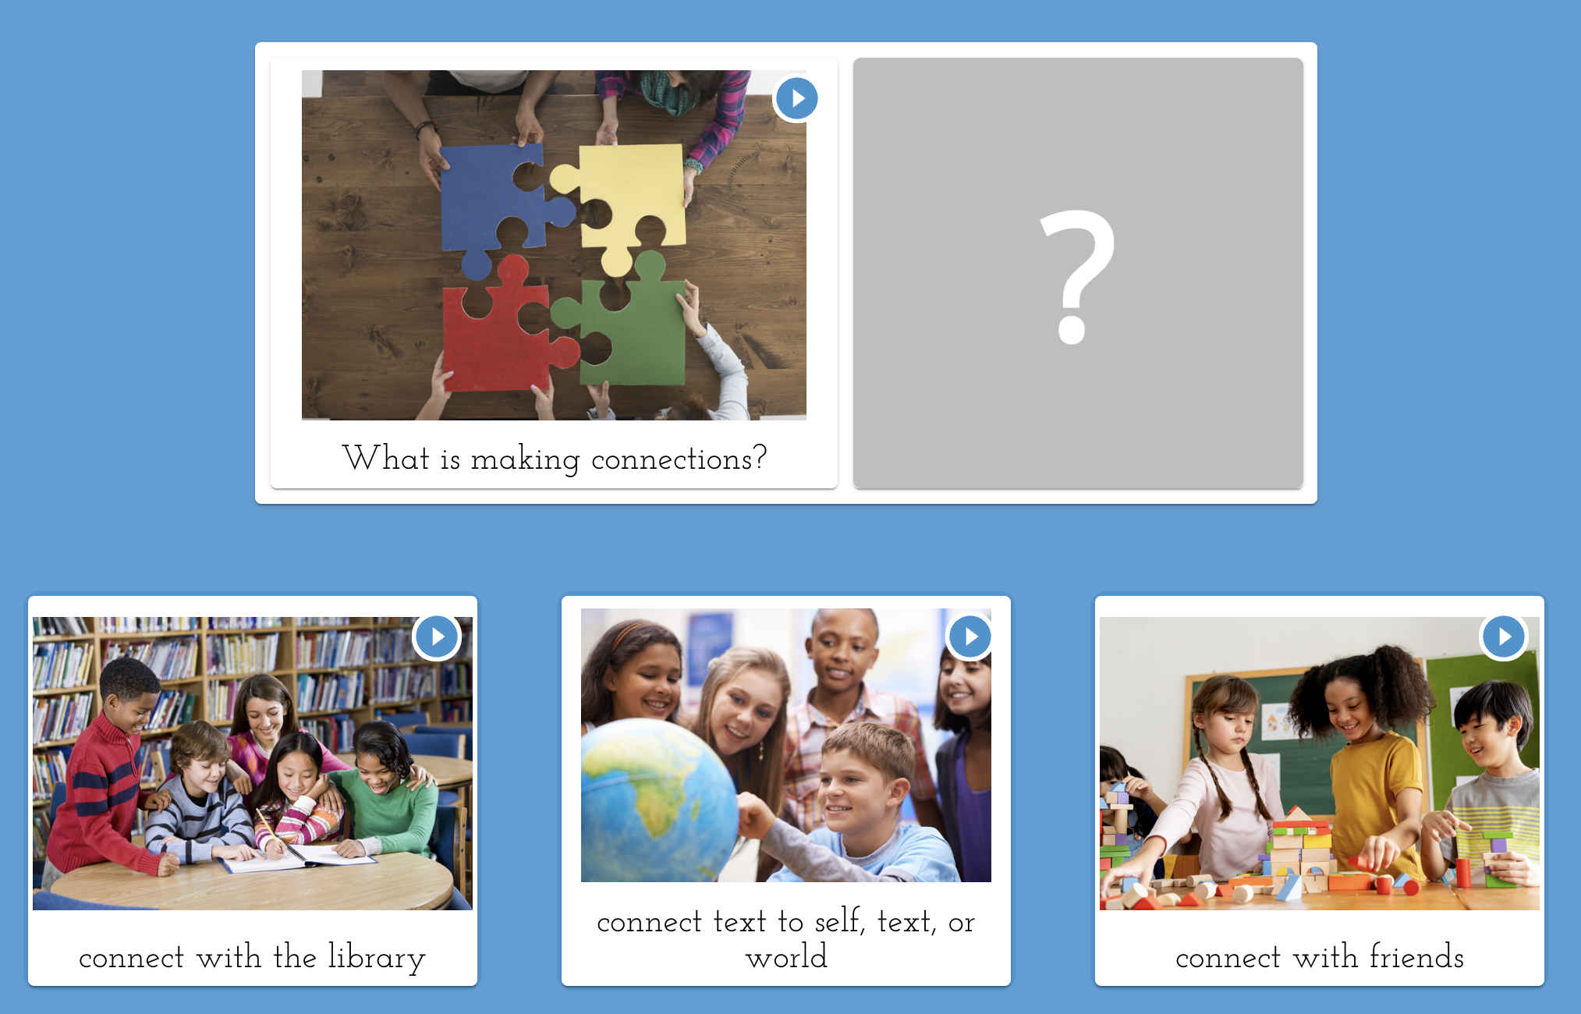
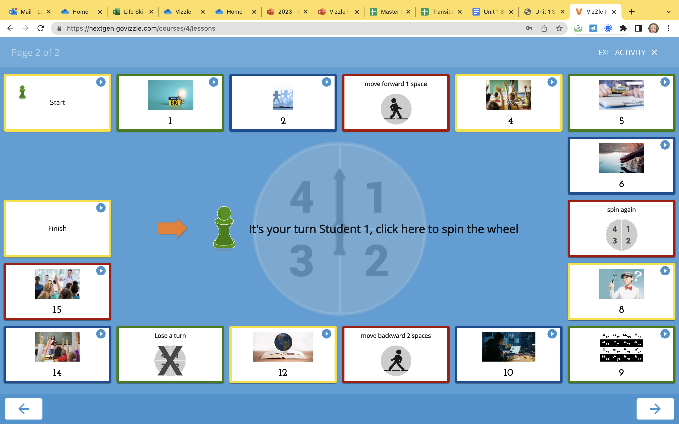
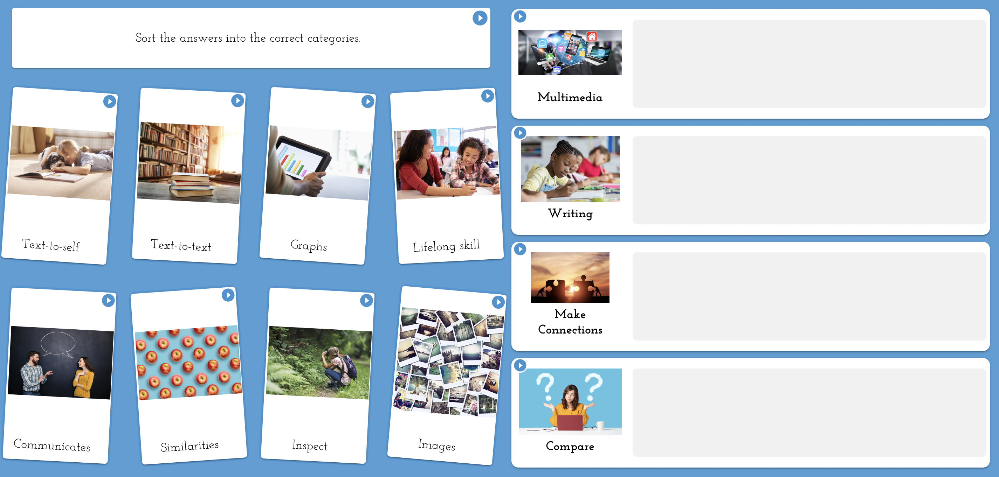
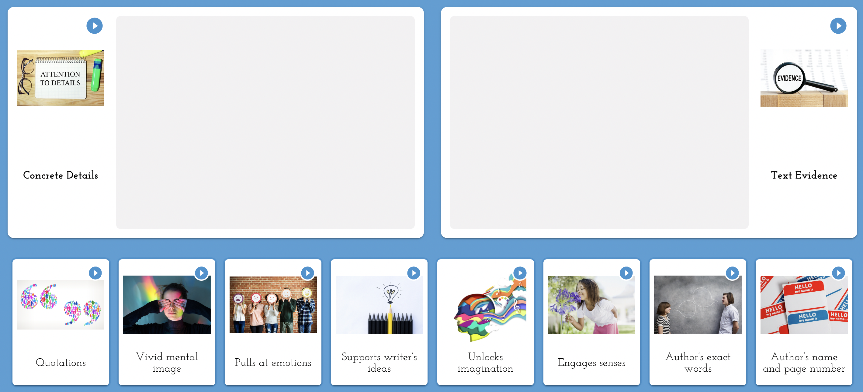
Leveled Activities to Assess, Instruct, & Generalize
Instructional Text
Vocabulary​
Matching
Multiple Choice​
True & False
Fill in the Blank
Sorting
Categorizing​
Sequencing​
Short Answer
Essay​
Game​s
Notes:
UDL
Endless opportunities on how to both teach as well as have a student demonstrate what they know!
Mix and match templates or edit or author content to create lessons supporting diverse goals and objectives!
Custom student response can be short answer, essay, drawing, etc. Truly endless opportunities

Slide 13
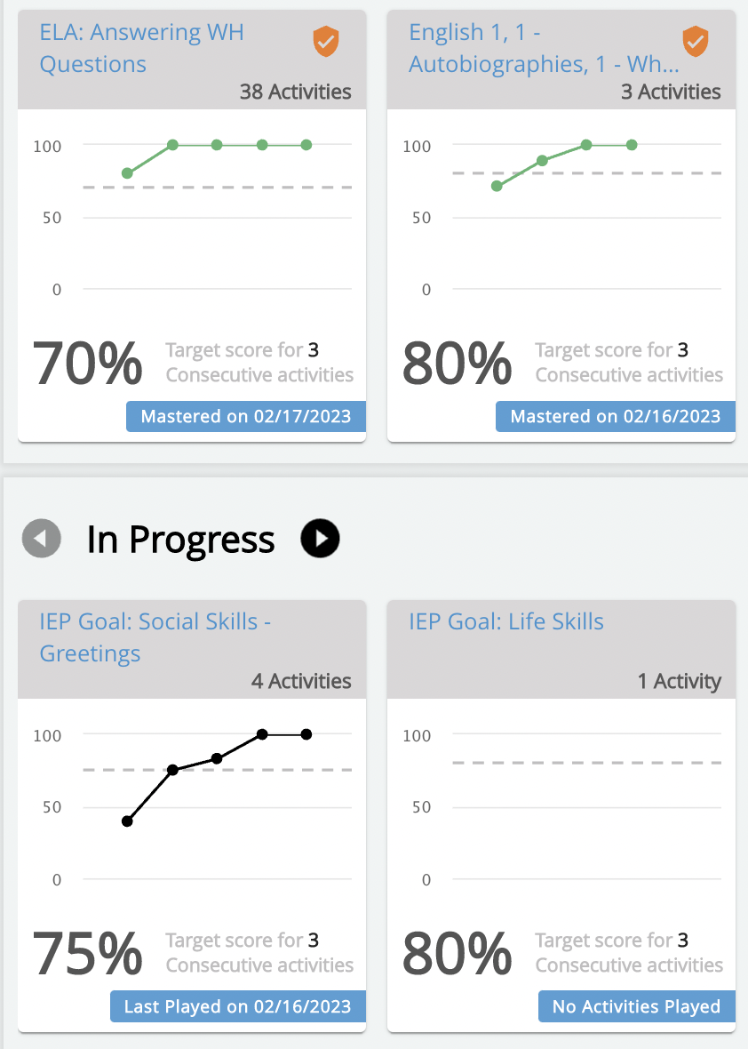
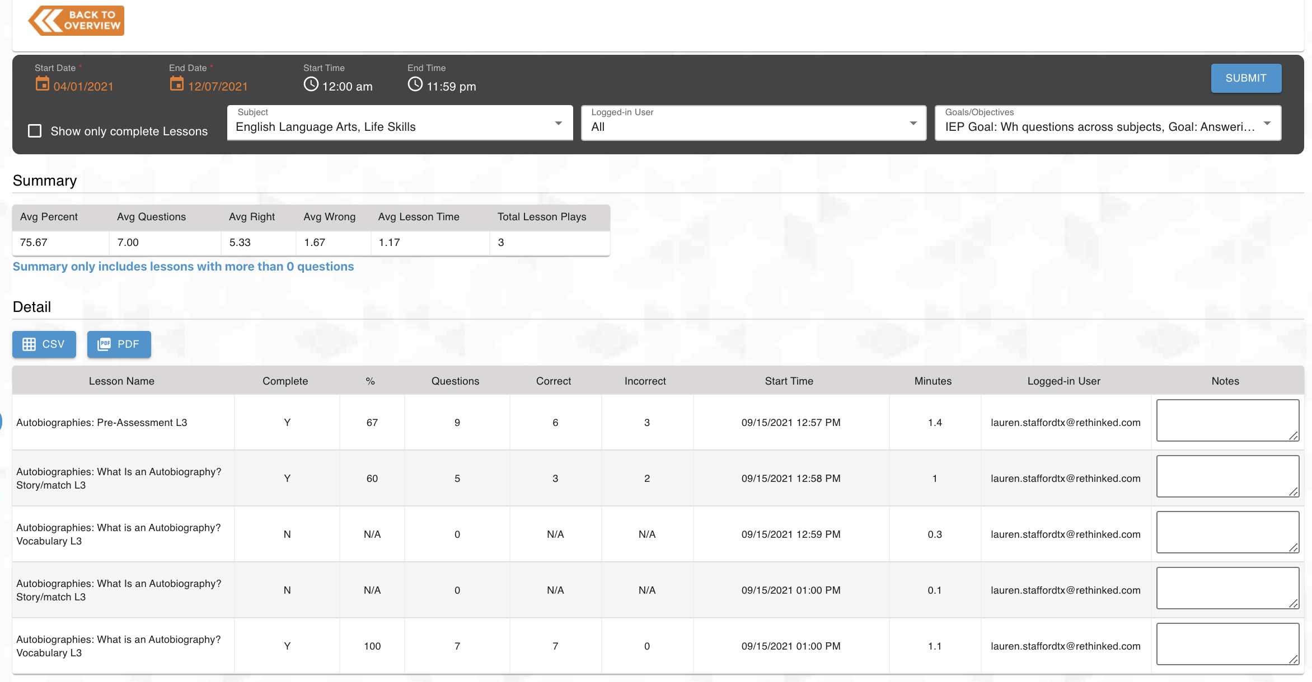
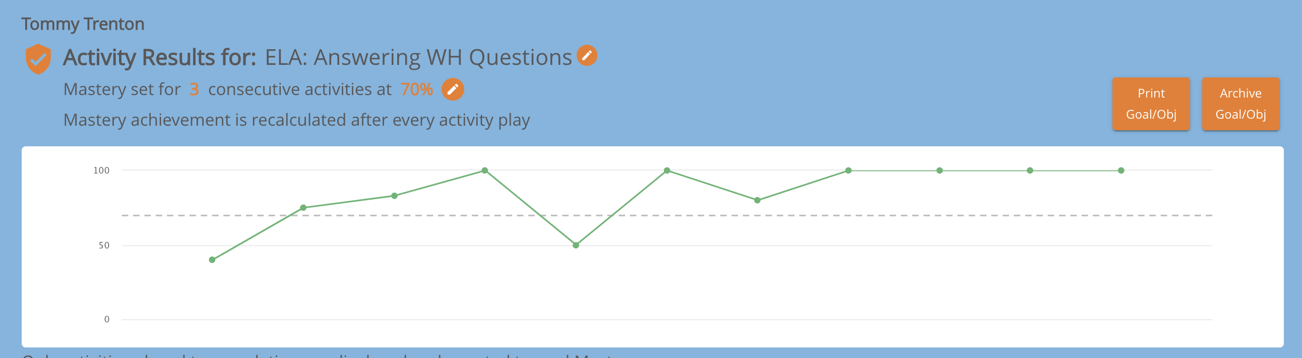
Data Tracking & Progress Monitoring
Automatic collection of data
Data filtered by topic or IEP goal
Teacher notifications for goal mastery
Administrative dashboard
Downloadable reports
Observational assessments (Fall 2023)
Notes:
Differentiator between us and competition… automatic data collection
Set goal mastery to match IEP criteria
Teacher notifications for goal mastery
Dashboard with easy to view progress
Observation checklists will be new for Fall 2023… being released with the SPED Skills Suite

Slide 14
Brand New Special Education Skills Suite (Fall 2023)
Grade-banded Curriculum
New Courses Include:
Life Skills
Social Skills
Transition/Vocational Skills
Notes:
Resources Fostering Student Growth and Independence
We recognize our students with IEPs have a diverse set of goals and objectives, and skill needed to communicate, navigate, and grow into independent adults. Our new skills suite provides a brand new way to introduce, practice and generalize real-world skills in and out of the classroom. What is different? We provide structured resources (aligned to standards), unit guides, lesson plans and a set of activities that makes planning and implementation easy. This includes NEW observational assessments to check, monitor, and expand skills in communication, daily living, and the transition into the real world. Each topic includes pre/post assessments, interactive online lessons, and offline leveled activities for a truly hands on experience.

Slide 15



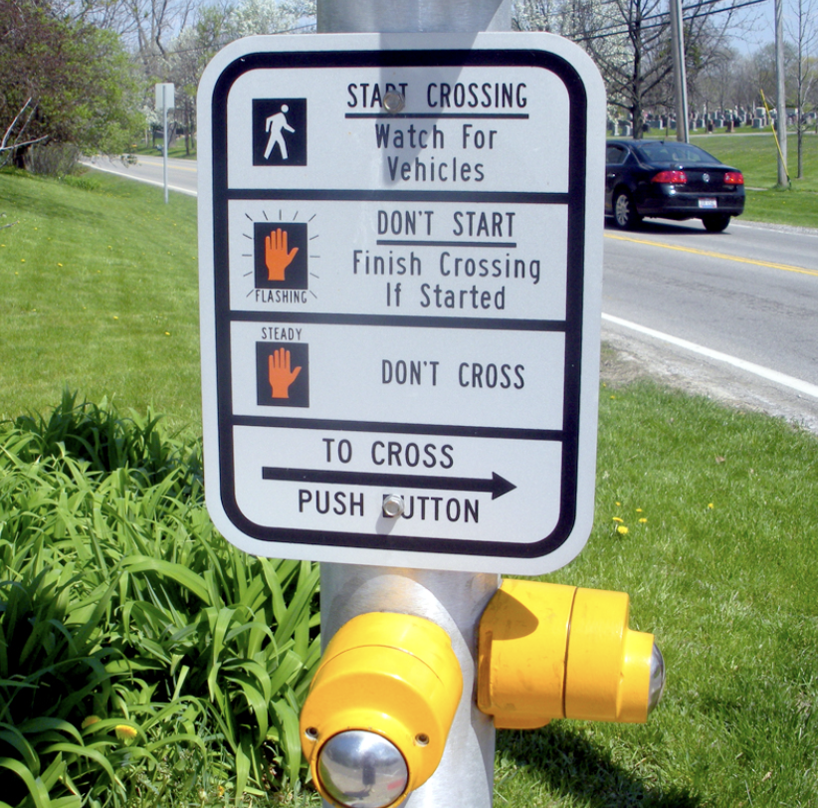

Life Skills Suite
Courses:
K-2, 3-5, 6-8, 9-12
Units:
Personal Care
Independent Living
Health Management
Tools for Independence
Money Management
Safety Practices
Community Access
Notes:
Dedicated to moving students towards their highest level of independence at home, school, and community.
Ex: Independent Living
K-2: About Me
3-5: Giving Information
6-8: Personal Information
9-12: Oversharing

Slide 16

Social Skills Suite
Courses:
(K-2, 3-5, 6-8, 9-12)
​
Units:​
Decision Making
Relationship Skills
Self-Awareness
Self-Management
Social-Awareness
Notes:
Promotes positive socialization, communication and interpersonal skills in and out of the classroom.​
Ex: Social Awareness
K-2: Sharing Feelings
3-5: Togetherness
6-8: Social Belonging
9-12: Empathy
​
ervations within the data and reporting suite in Vizzle.

Slide 17





Transition and Vocational Skills
Course: AGES 14-22
Units:
Self-Advocacy
Self-Determination
Personal Management
Interpersonal Skills
Empathy Skills
Job Seeking Skills
Employment Settings
Employability Skills
Career Attire
Career Development
Careers in the Community
Job Demands
Job Performance
Workplace Awareness
Notes:
Focus on career readiness as students plan for the transition from school to work, trade school, college, and other post-secondary options.
Transition and Vocational units provide supports as students start transition planning at age 14. ​
Ex: Job Seeking Skills
Interests and Skills
Applying for jobs
Resumes
Interviews

Slide 18
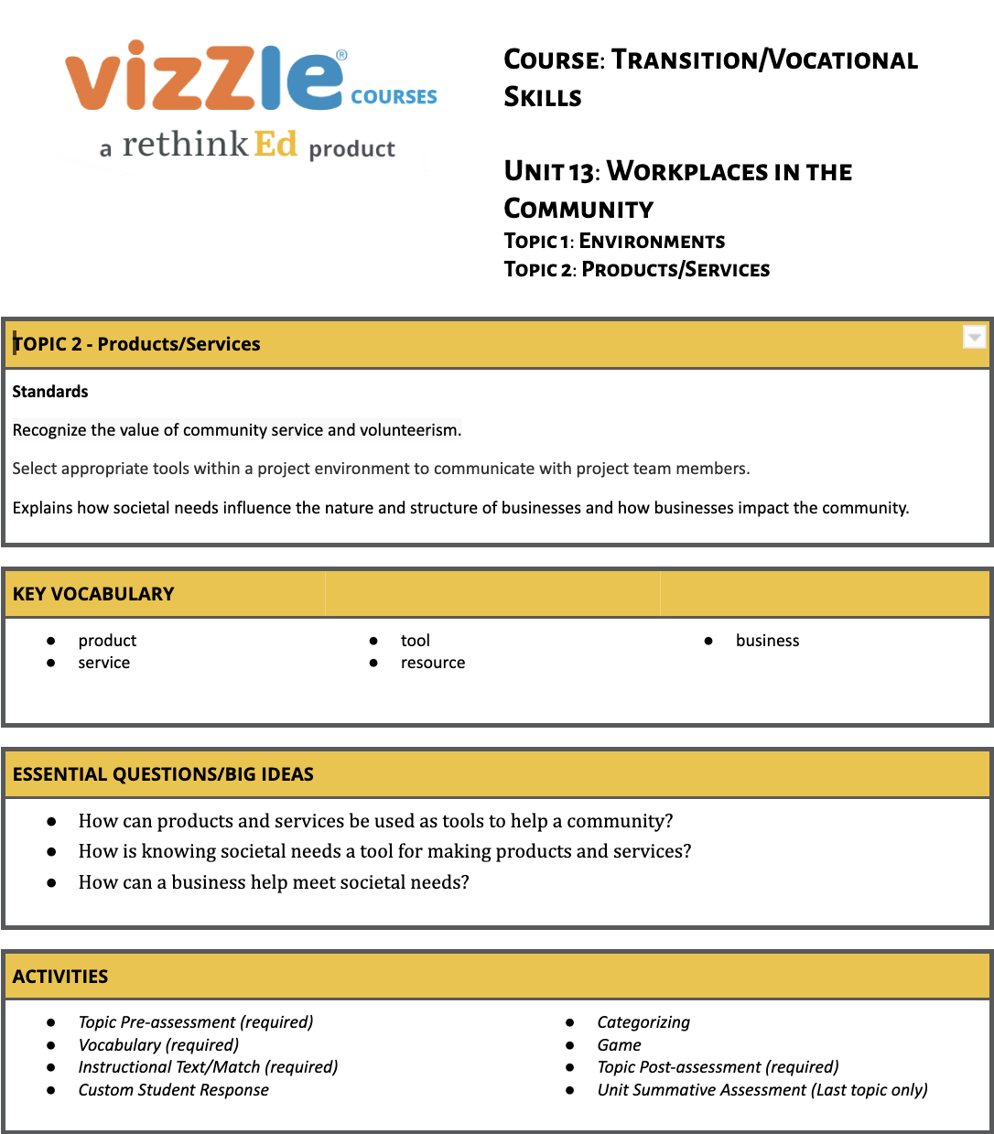
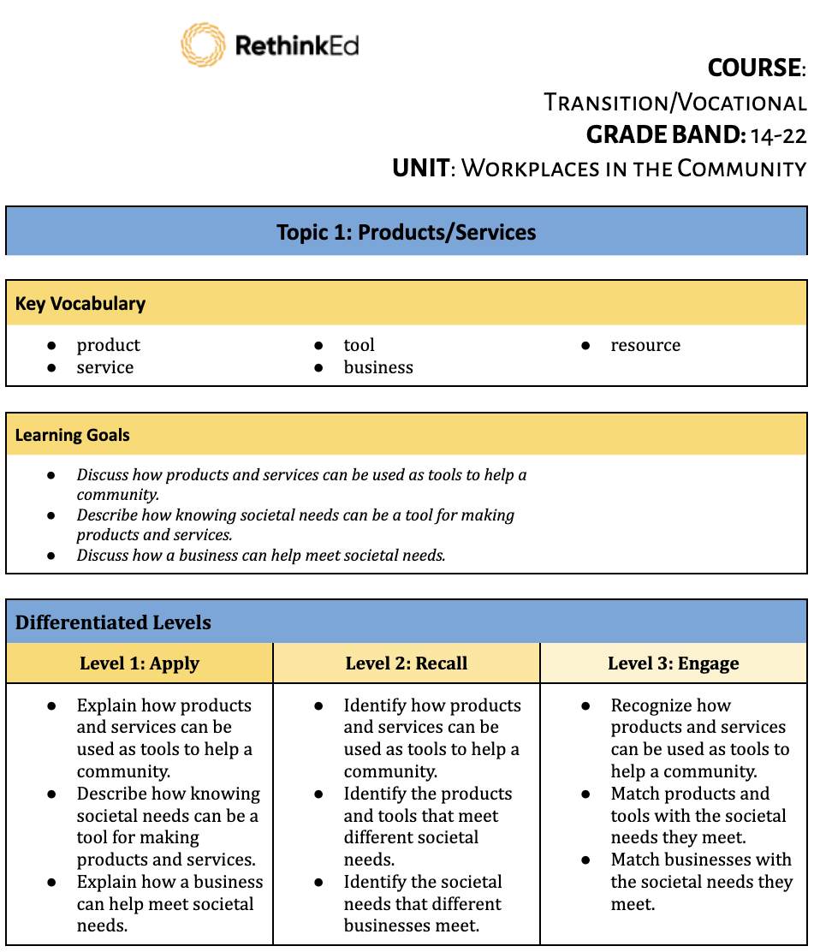
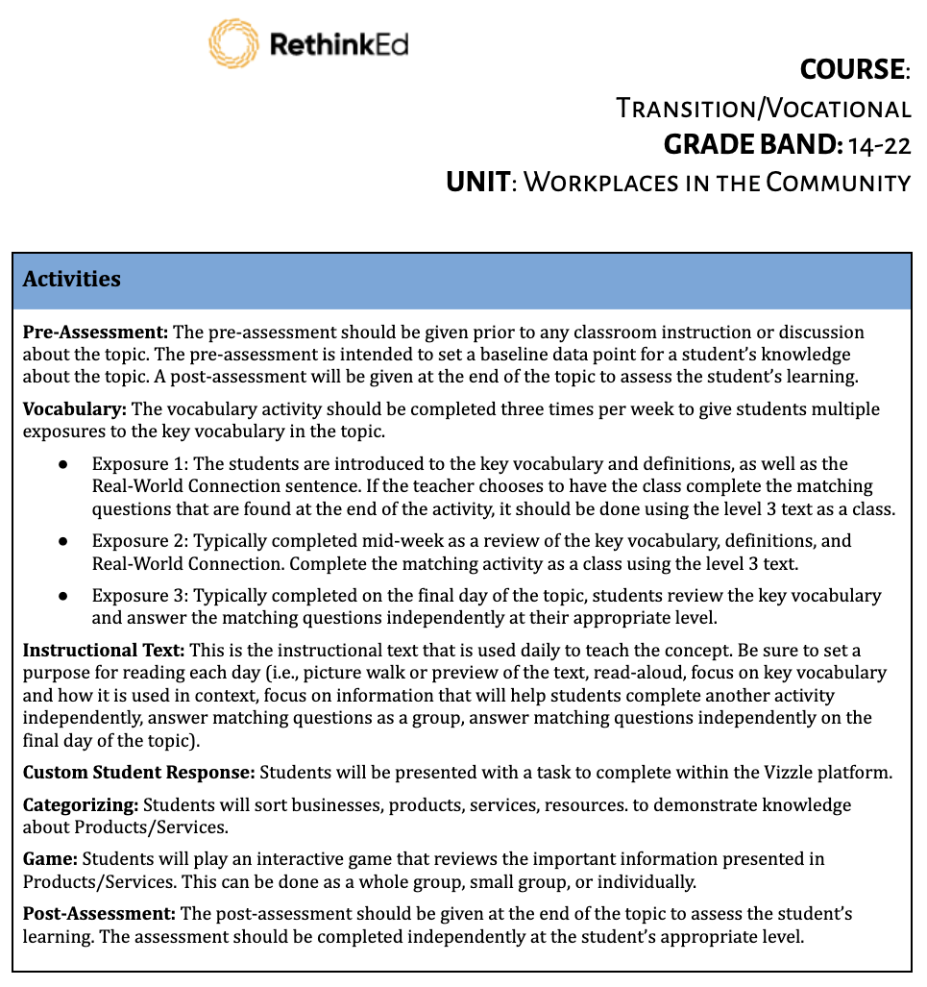
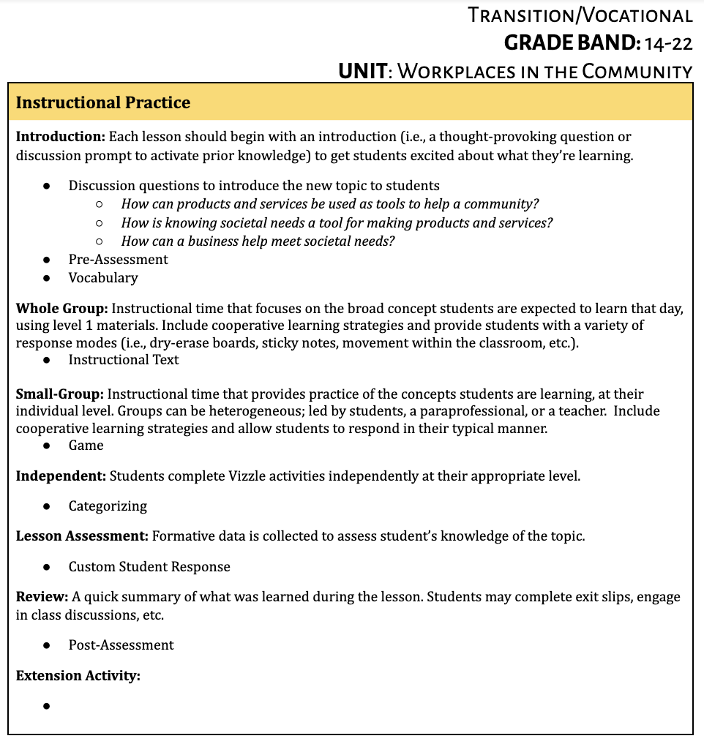
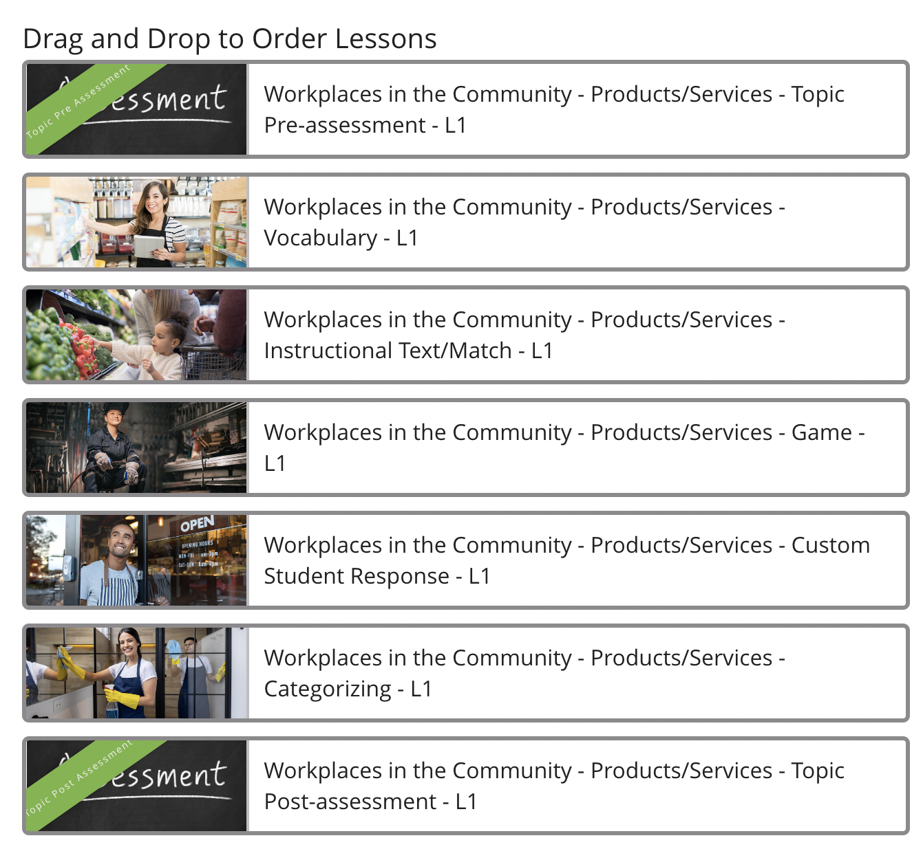
Transition and Vocational Skills Sample
New Extension Activities
Sample: Unit Guide
Sample: Lesson Plan
Notes:
Lessons are crafted with a focus on key vocabulary, to build comprehension and layer in generalization activities. Books with real photos to bring experiences to life, and supporting activities to encourage independence. New extension activities encourage student engagement with hands on application. Observational assessments will allow teachers to track and monitor skill acquisition in real time, targeting skill accuracy and independence, participation and engagement, prompting and more. This will allow teachers to share progress in Vizzle in a whole NEW way - every step of the way.

Slide 19

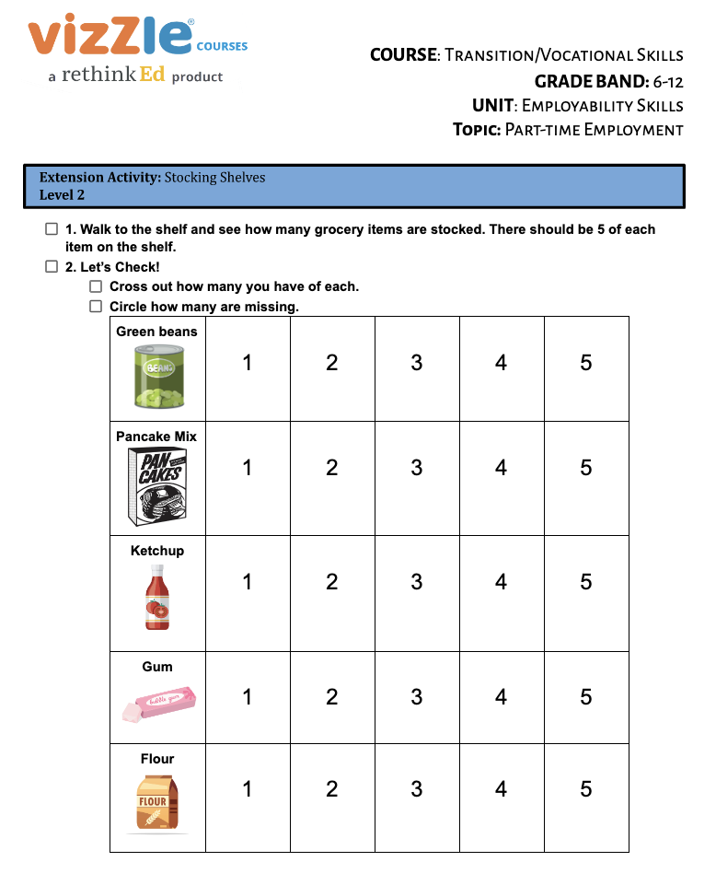
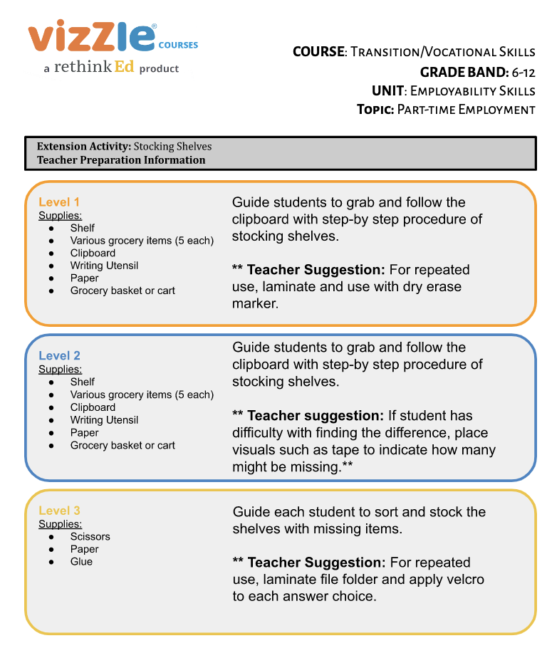
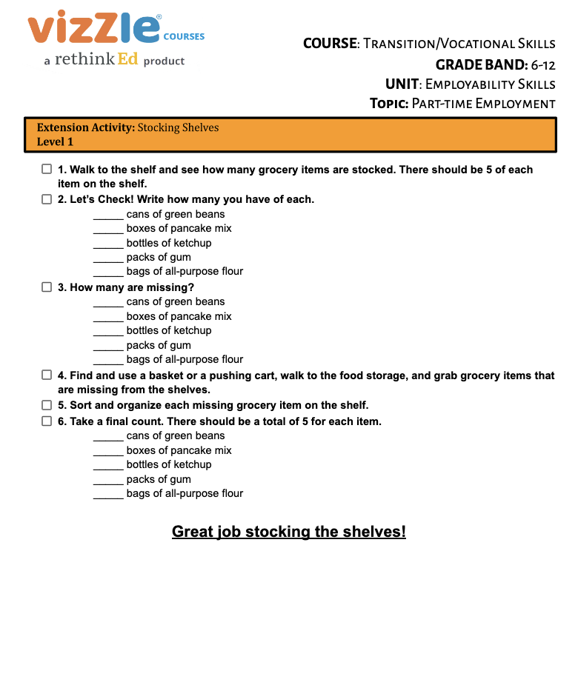
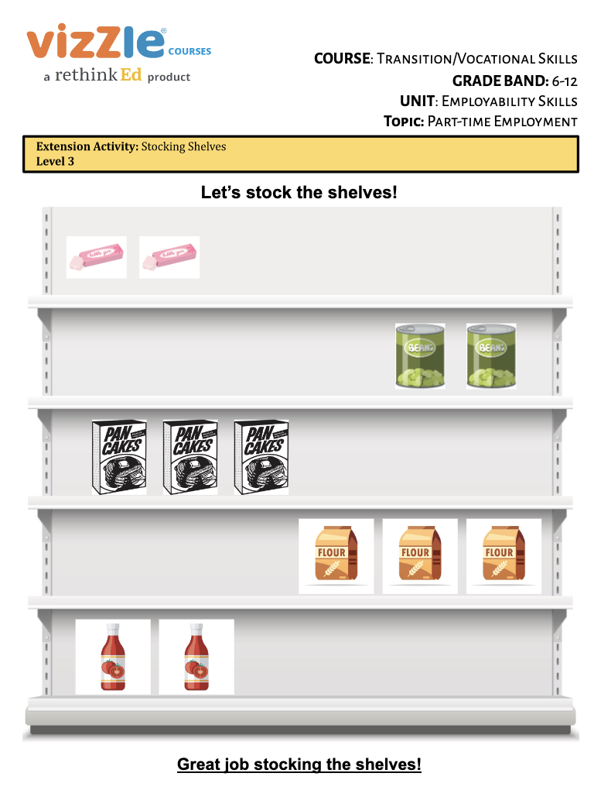
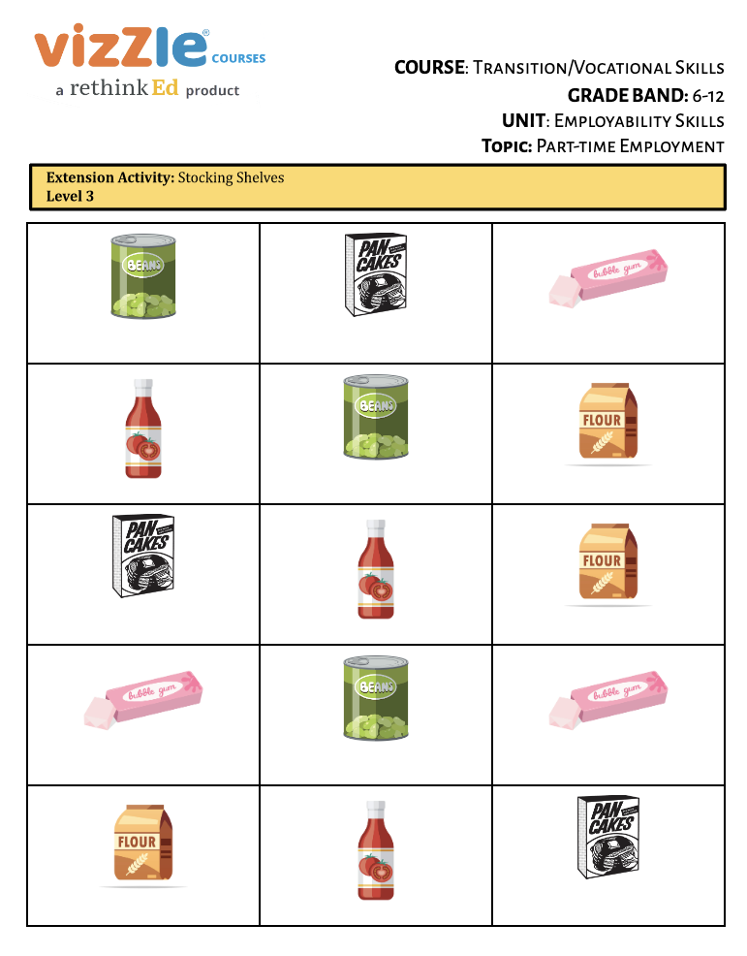
Printable Hands-On Extension Activities
Samples:
Environments
Part-Time Employment
Notes:
Extension activities move learning from the computer, to hands on experiences in the classroom and community. All extension activities include leveled teacher instructional supports, and leveled student materials. Example: Setting up a mock work environment for students to practice social skills, chain of command, following directions, and practicing specific skills for vocational opportunities in your local community.

Slide 20
Try Vizzle Now!
Easy
Engaging and interactive
Comprehensive
Standards-aligned
IEP focused
Data-driven
Notes:
Remember, our Vizzle suite includes resources for academic intervention and enrichment with resources for students with diverse educational needs. RethinkEd provides supports for the process, from MTSS, professional development, SEL, Mental Health and Wellness, Behavior and more. We look forward to the opportunity to collaborate as partners in education.

